Slide 1
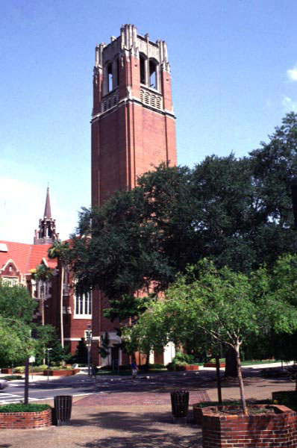
Certificates:
“The Other Academic Credential”
Certificate Application and Processing System Roll-out
September 10, 2014

Slide 2
Certificates:
Were the purview of departments, colleges, schools
Used for enhancement or recognition
Used as “gateway” strategy to encourage prospective students to seek degree programs
Very little institutional oversight
Available at the undergraduate, graduate and professional levels

Slide 3
Certificates:
SACS considers certificate programs to be academic programs and the certificate to be an institutionally awarded credential requiring institutional controls
** “…. SACS defines “educational program” as a coherent set of courses leading to a credential (degree, diploma, or certificate) awarded by the institution (p. 112 of the resource manual)

Slide 4
Certificates:
Institutional Control and Oversight:
Eligibility
Tracking
Posting to official record
Reporting

Slide 5
Certificates:
Administrative Requirements:
Build application system for prospective and
currently enrolled UF students
Create monitoring system at the student and
course/program level
Provide for posting earned certificates to UF transcript
Data capture and query for reporting

Slide 6
Certificates:
Application Procedures:
All certificate programs must transition to the new central UF application
Students already attending an approved certificate program will NOT have to re-apply
Applicants who have already applied will NOT be required to submit another application as part of the transition
Currently enrolled UF certificate applicants will have an abbreviated version of the application and will NOT have to pay an application fee

Slide 7
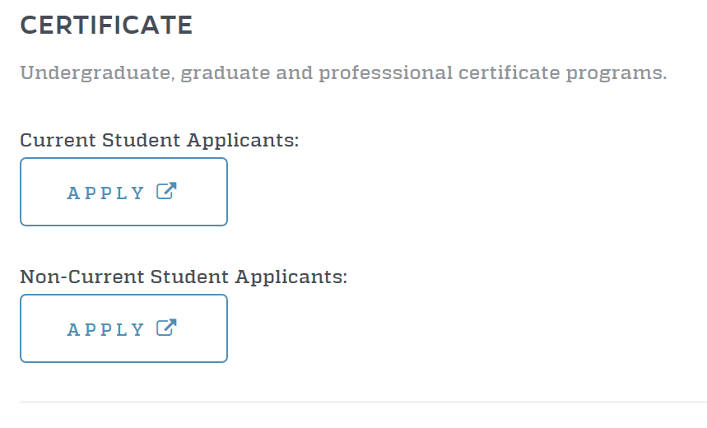
Certificates:
Application Location:
http://www.admissions.ufl.edu/start.html

Slide 8
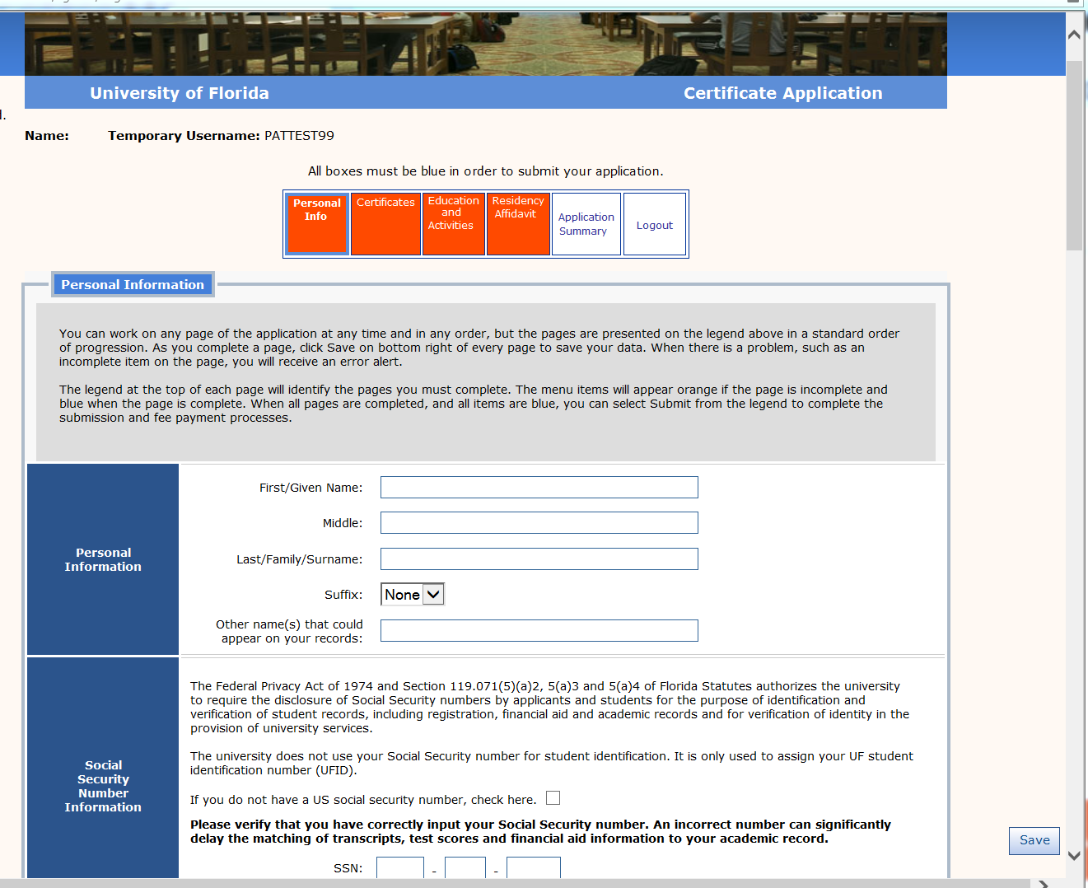
(screen shot)

Slide 9
Certificates:
Non-Current Student Applicants:
Upon submission the application will download nightly to Application Services who will review file for fee, conduct and residency
Upon completion of the review, a referral will be placed on your processing screen (CAPCO) within ISIS Admin
College/Department has the option to Admit, Cancel or Deny
Updates such as term and program changes will need to be e-mailed to Applicant Services at CERTIFICATES@admissions.ufl.edu

Slide 10
Certificates:
Non-Current Student Applicants:
Jump Key-CAPCO for College/Department Processing Page
Click within “To App“ column to view the student’s application
Copy of unofficial transcripts (If uploaded by applicant) are included
Unofficial transcripts can be used for the initial review and offer

Slide 11
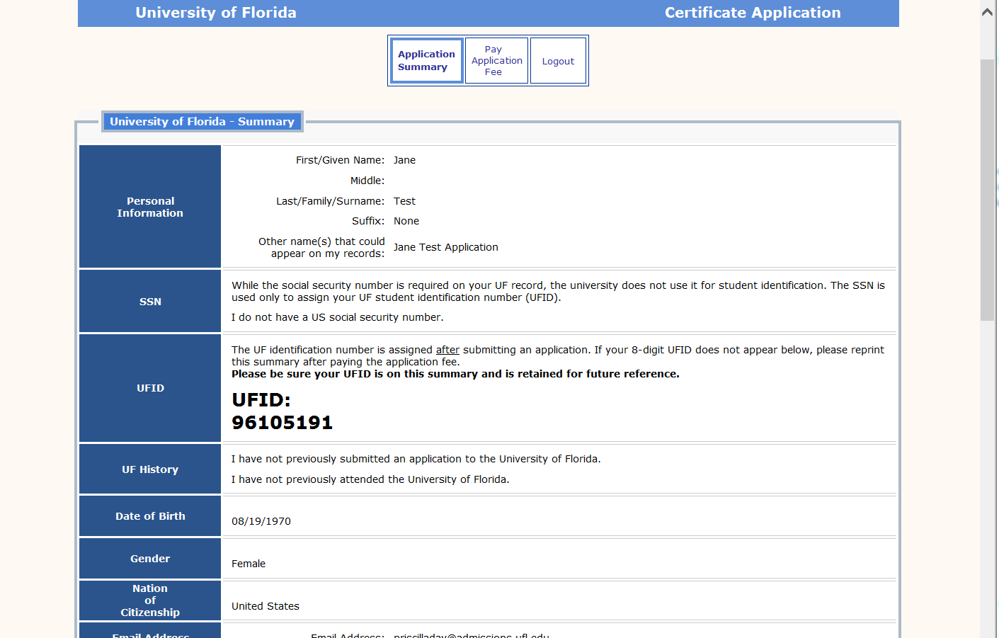
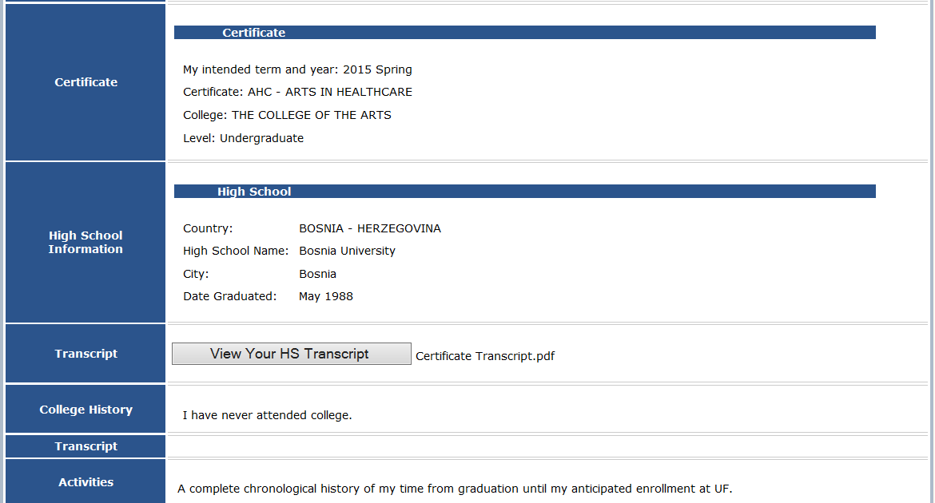

Slide 12
Certificates:
Current Student Applicants:
Nightly batch program will place the applicant’s referral on screen CAPSC for applicant’s college to approve
Referral will not appear on CAPCO until the student’s college approves the student to take on additional certificate responsibilities
Once on CAPCO the College/Department has the option to Admit, Cancel or Deny the referral
Updates such as term and program changes will need to be e-mailed to Applicant Services at CERTIFICATES@admissions.ufl.edu

Slide 13
Certificates:
Current Student Applicants:
Jump Key-CAPSC for Student’s College (Enrolled Students Only)
Jump Key-CAPCO for College/Department Processing Page
Click within “To App“ column to view the student’s application

Slide 14
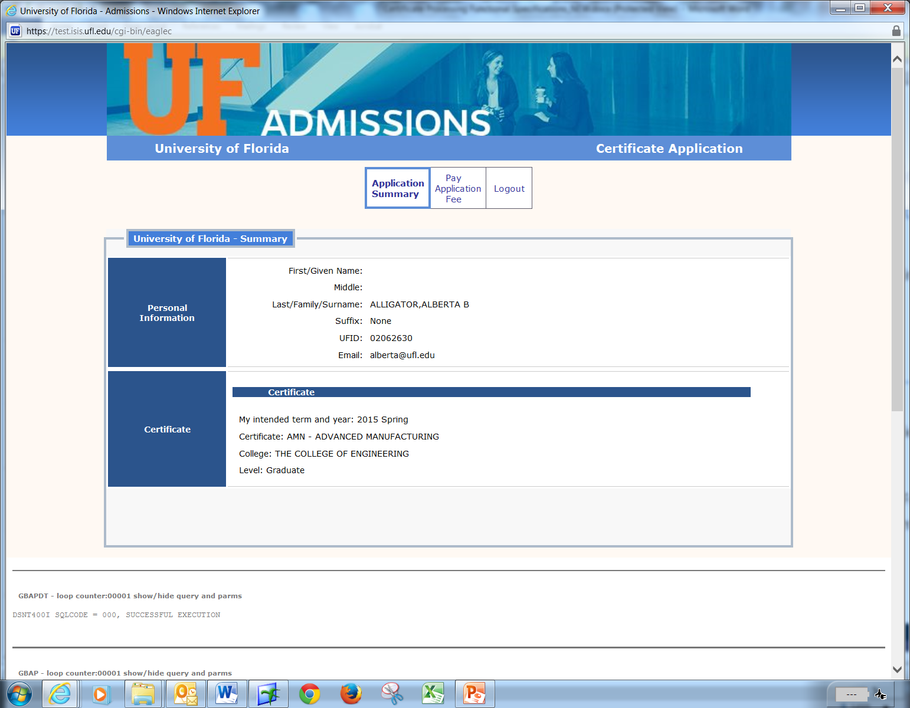

Slide 15
Certificates:
Admitted certificate applicants will merge over to the Registrar’s Office upon the receipt of all official documents
Please communicate to your admitted certificate applicants that they should immediately forward their official transcripts to the Office of Admissions if they have not already done so
Without the receipt of official transcripts the offer cannot be finalized and the certificate applicant will NOT be merged to the Registrar’s Office and allowed to register

Slide 16
Certificates:
ISIS Admin- Registrar System:
Redy table is used to monitor and maintain students enrolled within your certificate program
To Access, enter “redyco” into the jumpkey in the upper left corner of your ISIS Admin screen

Slide 17
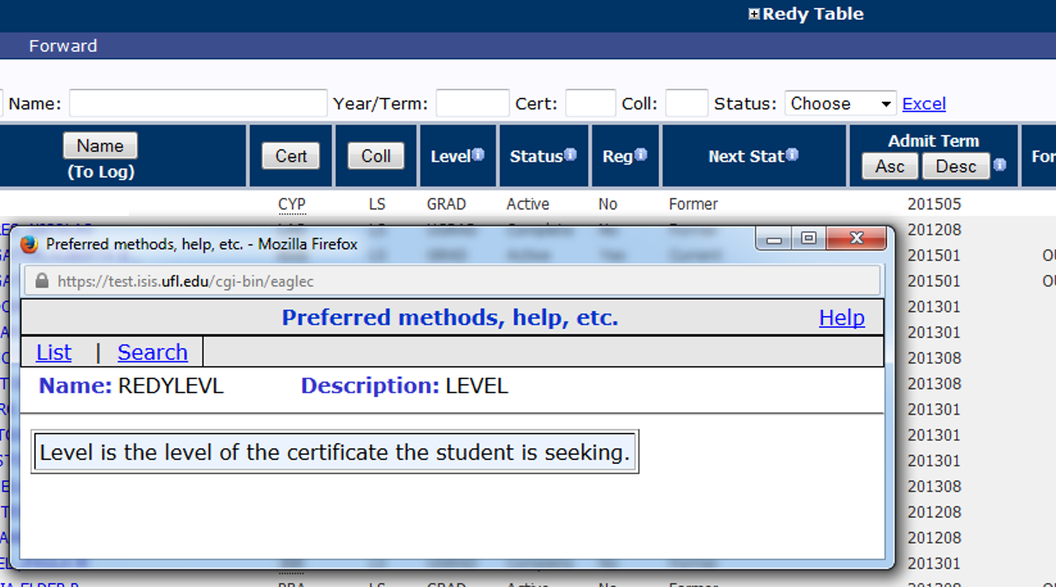
Redy Table:
Certificates:
Click on the “i” in the blue circle to get a pop-up window with more information about a column
This feature is available for all certificate system screens

Slide 18
Certificates:
Redy Table:
Lists all admitted students (who have completed the merge process) in the certificate program(s) for which you have security
You can sort the list by any column with a button in the header

Slide 19
Certificates:
Certificate Codes:
Hover over the code in the “Cert” column to see the full certificate name

Slide 20
Certificates:
Redy Table Search/Filter:
You can search/filter by UFID, Name, Year/Term, Certificate code, or Status
Enter a value in one of the fields at the top, then click “Refresh”

Slide 21
Certificates:
The Status Column:
Active = student is actively seeking the certificate
Inactive = student is no longer seeking the certificate
Complete = certificate already posted to student’s transcript as completed

Slide 22
Certificates:
To Change a Status:
Click on the student’s UFID
xxxxxxxx

Slide 23
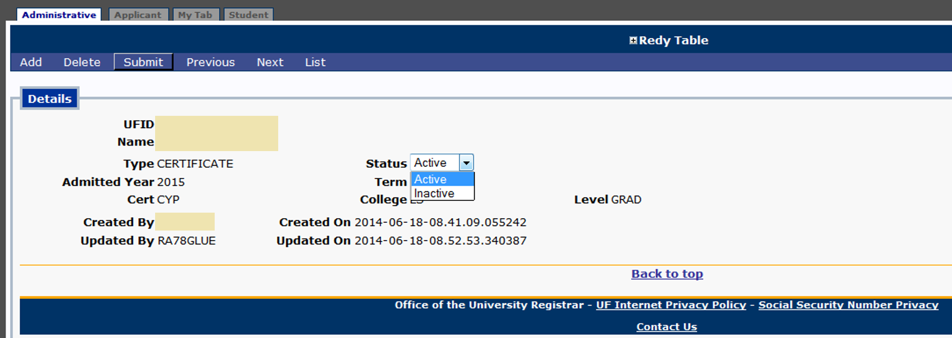
Certificates:
To Change a Status Continued:
Use the drop-down menu to select, then click “submit” to save status
Click “List” to return to the full Redy Table

Slide 24
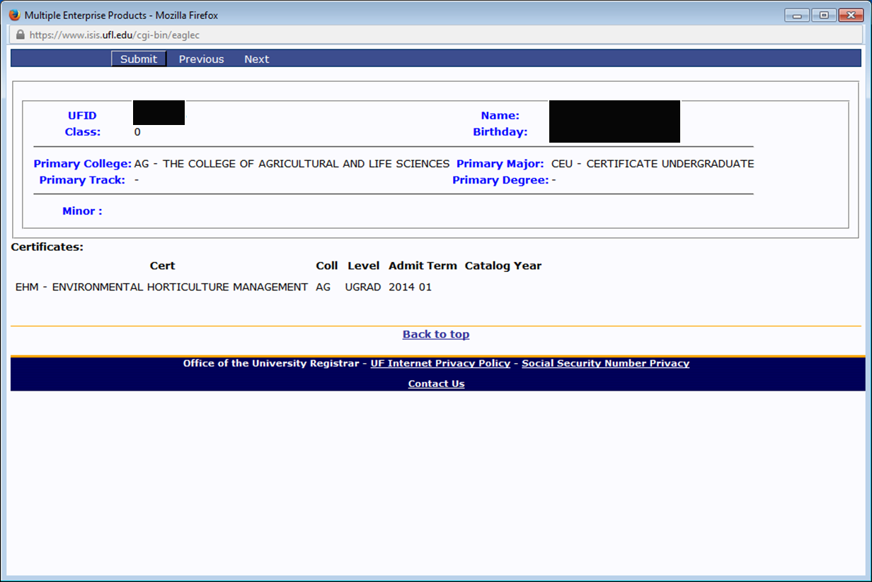
Certificates:
To Track Progress of Certificate Student:
Once the student is “Admitted” on the REDY screens, you can view them in the student records system on the “Academic Programs” link from “s21” in ISIS Admin
Certificate students not pursuing a degree will have CEU, CEG, or CEP as their major

Slide 25
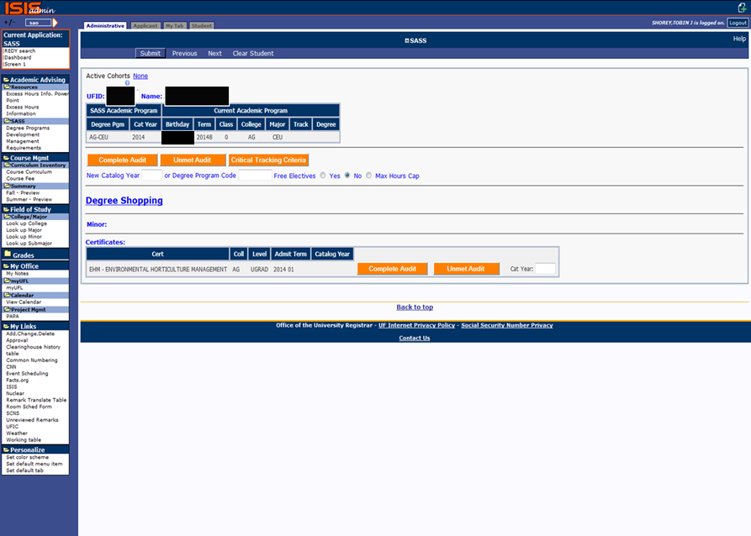
Certificates:
To Track Progress of Certificate Student:
To run a certificate audit go to the audit page (jumpkey SAO, or The “Degree Audit” link on the Student Tab).
Enter the student’s UFID, then hit “submit”
Click “Complete Audit” next to the certificate
If the student does not have a certificate listed on the page, their certificate application has not been processed

Slide 26
Certificates:
Certify:
During term of completion student should apply via ISIS requesting that the certificate be awarded
Department/College will certify with the OUR that all requirements have been met using jump key CERTIFY
There is no change in the certification procedure that is currently being used to award certificates and to place the credential statement on the UF transcript

Slide 27
Certificates:
Security Access:
Use of the certificate system requires an update to your security profile and must be requested via the Registrar’s Office
You will need to clarify if you need department, college or both when completing your security access form
Please include your specific certificate name (and code(s) if known)
Please e-mail the OUR Security Team at security@registrar.ufl.edu if you need to have your security profile updated

Slide 28
Certificates:
Contact Information:
Admissions: Rick Bryant
rjbryant@ufl.edu
Registrar: Mallori Wojcik
mallori@registrar.ufl.edu
Degree Audits: Toby Shorey
tshorey@ufl.edu
Certificate Security: Registrar Security Team
security@registrar.ufl.edu

